Slide 1
EXTREME AQUATIC ENVIRONMENT
GROUP 30

Slide 2
Content
Description of the aquatic environment
Examples of extreme aquatic environments
Features of extreme aquatic environments
Examples of organisms in extreme aquatic environments

Slide 3
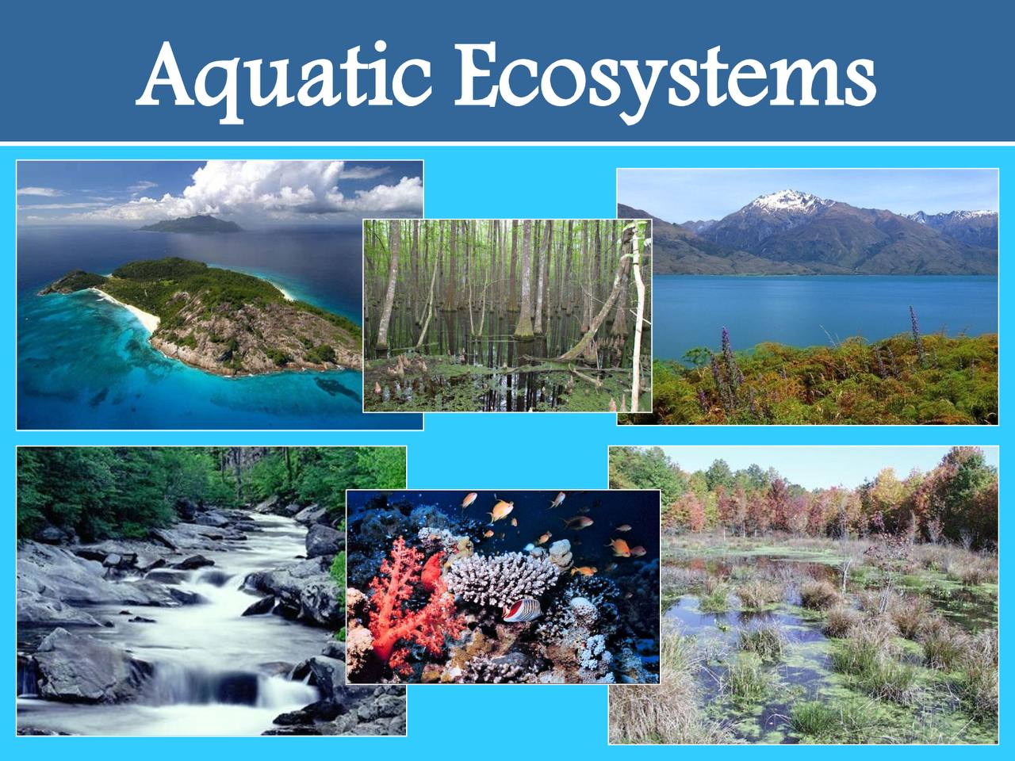
Description Of Aquatic Environment
Any water based ecosystem.
Water is the most common substance on earth.
71% of the earth’s surface is covered by water (www.usgs.gov).
Fig.1 Aquatic Ecosystems

Slide 4
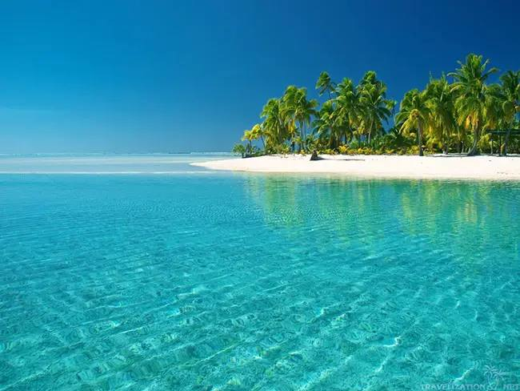
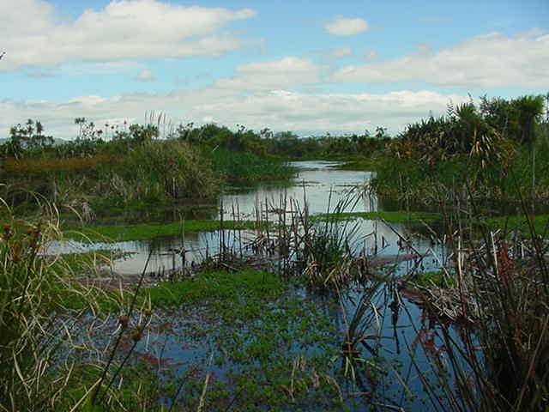
Examples Of Extreme Aquatic Environments
Fig.2 ocean Fig.3 Wetland

Slide 5
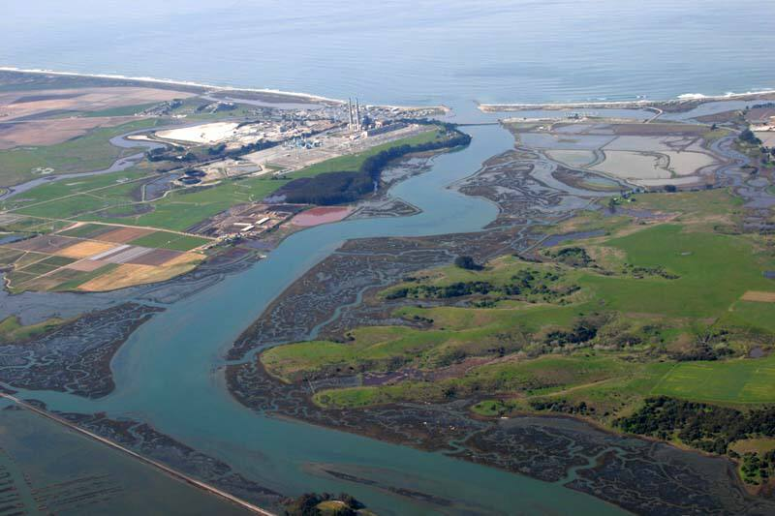
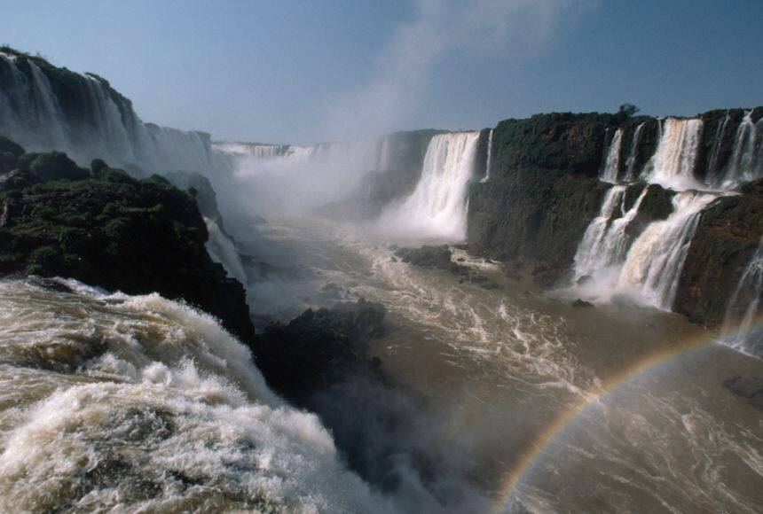
Examples Of Extreme Aquatic Environments
Fig.4 Estuary Fig.5 Fast-flowing lotic system

Slide 6
Extremeties Of The Ocean Environment
Increased salinity
Low transmission of light thereby separating the environment into photic, disphotic and aphotic zones.
Plants are absent in the aphotic zones.
Animals in the aphotic zones are mostly bioluminescent.
Extremely reduced temperatures in oceanic depths.

Slide 7
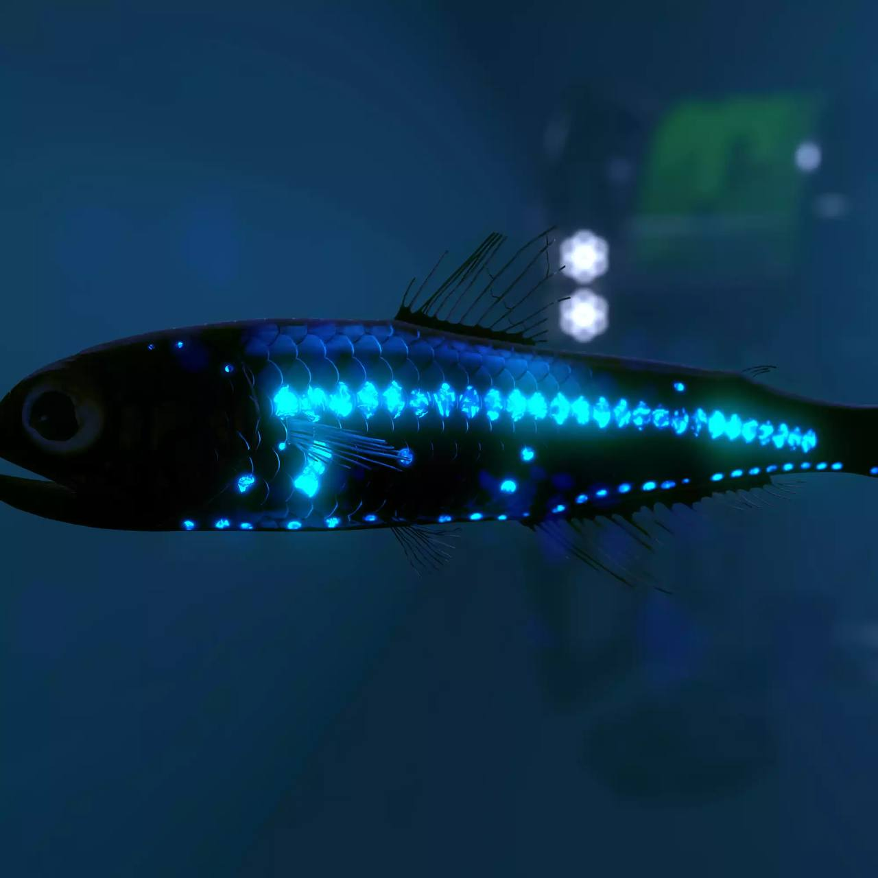
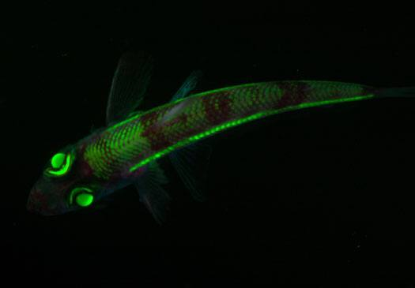
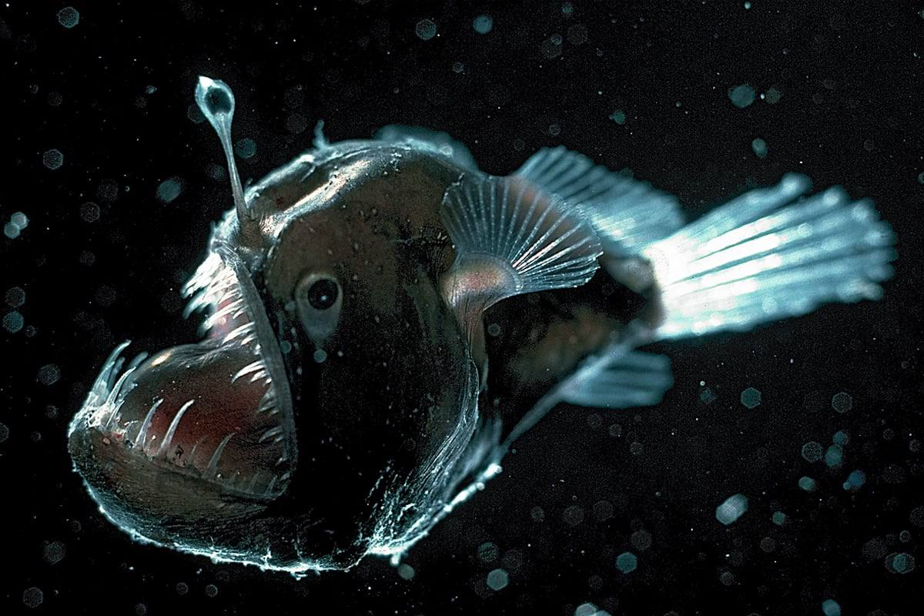
Examples Of Organisms In Ocean Environments
Fig.6 Lantern fish Fig.7 short nose-green eye fish Fig.8 anglerfish

Slide 8
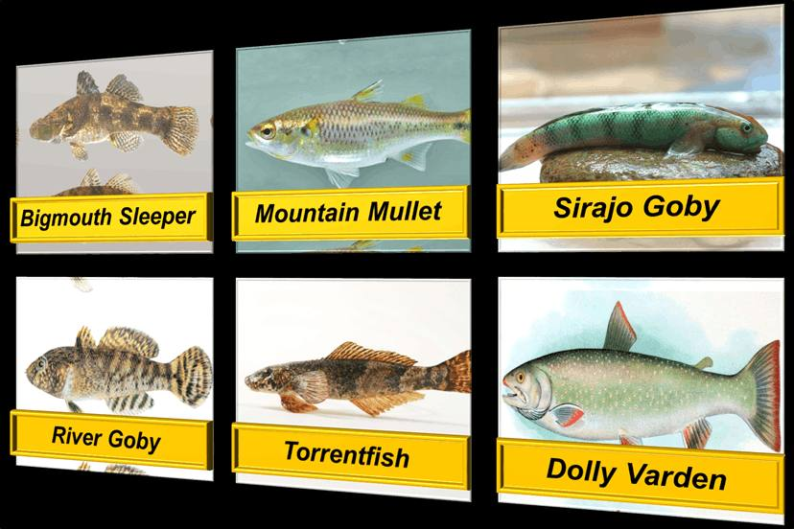
Examples Of Organisms In Ocean Environments
Fig.9 oceanodromous fishes

Slide 9
Estuarine Environment
Fluctuating salinity.
Flora and fauna is composed predominantly of organisms with advanced osmoregulation physiological systems.
Reduced levels of dissolved oxygen.
Presence of pneumatophores in mangrove plants to aid in root oxygenation.

Slide 10
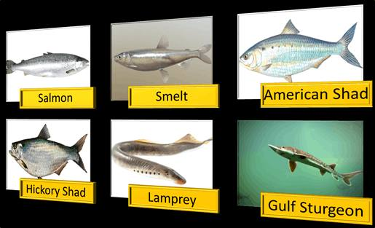
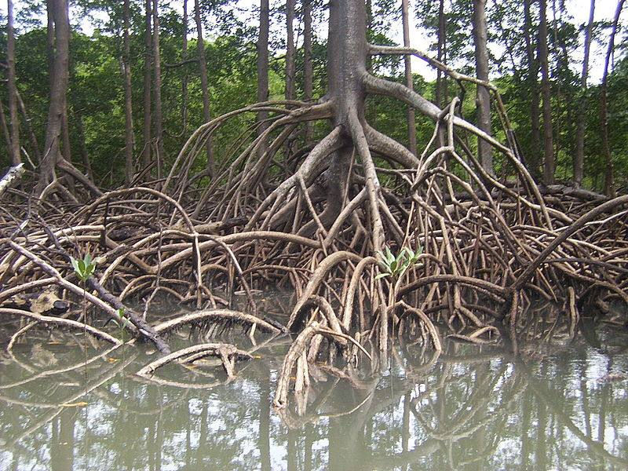
Examples Of Organisms Estuarine Environments
Wedge-like structure of estuaries allow for co-habitation of both anadromous and catadromous fishes.
Fig.10 amphidromous fishes Fig.11 Rhizophora

Slide 11
Wetlands
Peat-laden standing waters with a depth of not less than 6 metres at low tide.
Permanent wetlands may have anoxic and acidophilic soils.
Abundance of low-oxygen loving organisms.
Marine wetlands are composed of coral reefs and subtidal beds of sea grass

Slide 12
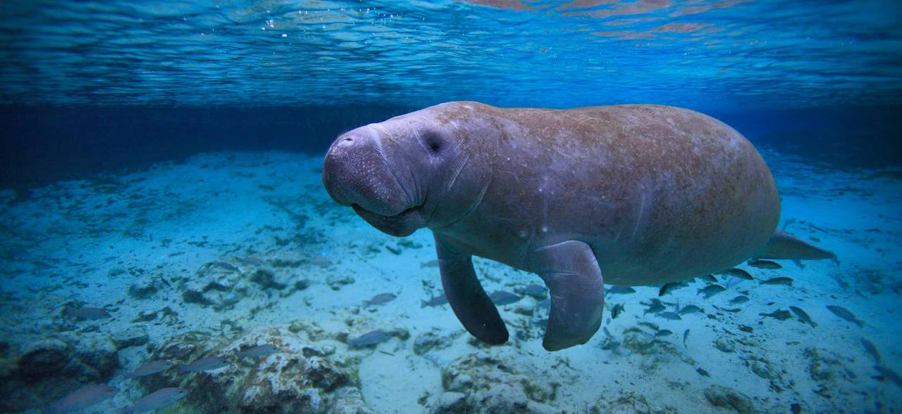
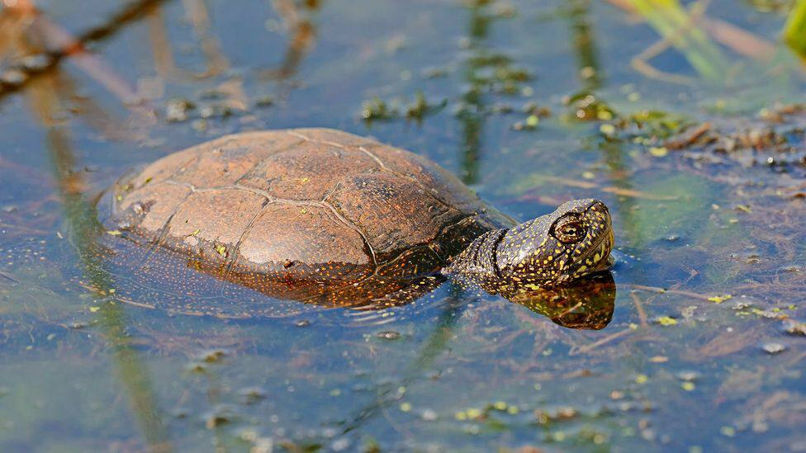
Examples Of Organisms Found In Wetlands
Sphagnum mosses
Fig.12 Dugong Fig.13 Marine turtle

Slide 13
Fast-flowing Lotic Systems
High turbulence
Abundant bottom feeders
Lack of pleuston
Varying dissolved oxygen content

Slide 14
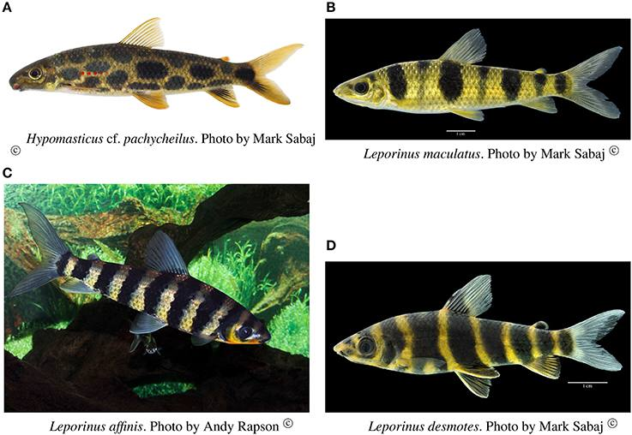
Examples Of Organisms In The Fast-flowing Lotic Systems
Bottom-dwelling potamoplankton
Fig.14 Rheophiles

Slide 15
Conclusion
The aquatic environment has massively adapted its biota with enigmatic features through its varying extreme environments.
Indeed extreme environments facilitate adaptation of improved homeostatic responses to harsh conditions. Thus, increasing the fitness and survival rate of organisms in harsh conditions as well as enriching biodiversity.

Slide 16
References
www.usgs.gov
Aquatic Ecology notes: F. E. Awortwi, PhD.

Slide 17
THANK YOU

Slide 18
Group Members
Oti Frimpong Esther Cindy 9216519
Sarkodie Evans 9218819
Wiredu Cudjoe Maxwell 9220619
Owusu Ansah Lordina 9221719
Adzrakor Gameli Richard 9196319
Mahama Abdul-Hakim Borenyi 9212019
Adomako Linford Dwamena 9195819

